Slide 1

DEPARTMENT OF AI&DS ENGINEERING DR. D. Y. PATIL INSTITUTE OF TECHNOLOGY, PIMPRI, PUNE
Project Based Learning II (217533)
Second Year (B.E.-AI&DS)
assist-u : recommendation of services for students
Presented By
Sujal Gosavi (56)
Mayuri Nikade (73)
Asim Pathan (75)
Kajal Jadhao (65)
Department of AI&DS,
Dr. D. Y. Patil Institute of Technology,
Pimpri, Pune-411018.
Under the Guidance of
Dr. Mithra Venkatesan
Prof. Sonali Sawardekar
Department of AI&DS,
Dr. D. Y. Patil Institute of Technology,
Pimpri, Pune-411018.

Slide 2
TABLE OF CONTENTS
01 Domain
02 Brief Introduction
03 Motivation: Need, Relevance and Scope
04 Literature Survey
05 Aim and Objective
06 Proposed architecture / Methodology
07 Proposed Algorithm
08 Block Diagram
09 Software and Hardware requirements
10 Advantages
11 Limitations
12 Application
13 Future Scope
14 Conclusion
15 References

Slide 3


Domain :
01
Web Development : The project builds a user-friendly platform using web development techniques for easy access to personalized recommendations near the college campus.
Machine Learning Integration : Utilizing machine learning algorithms, the project analyzes user data to generate accurate service suggestions, continuously improving recommendations based on user interactions.

Slide 4
Brief Introduction
02
"Hey everyone, We're excited to introduce you to AssistU, an innovative project specifically designed for students in our college.
AssistU aims to simplify the process of finding essential services near our campus, such as Mess, PG, laundry, and medical facilities.
By utilizing machine learning, AssistU provides personalized recommendations based on user preferences.
We collect star ratings from users to ensure accurate recommendations. .
AssistU is here to make your life easier. Let's dive into the details and explore the amazing features of AssistU!"

Slide 5


Motivation
03
The motivation behind the AssistU project stems from the recognition of the challenges and hurdles that students often face when navigating essential services in a new environment
Need : Students often struggle to find essential services near their college campus. AssistU addresses this need by providing a centralized platform for accessing these services.
Scope : AssistU covers a wide range of essential services including mess facilities, PG accommodations, laundry services, medical facilities, and potentially more based on user demand.
Relevance : AssistU directly addresses the needs and challenges faced by students, making it highly relevant to the target audience.

Slide 6

04
LITERATURE SURVEY

Slide 7
Sr.no | Title of the Research Paper | Name of the Author | Year of publication | Methodology | Advantages | Disadvantages | Future Scope
1. | Online Mess Recommender System using Sentiment Analysis | Mr. Nikhil Falke Mr. Abhishek Kiranrao Dabhade | 2023 | 1. Data Collection 2. Sentiment Based recommendation 3. Data-Driven Dining: Mess Recommendation System | Recommender systems can be used to provide personalized recommendations to individual users, which can lead to a more satisfying experience. | Recommender systems can be ineffective when there is not enough data about users or items. | 1. Advanced Recommendation Algorithms 2. Continuous User Feedback Integration 3. Expansion to Additional Services 4. Integration with Emerging Technologies
Summary: In this system the user can directly search, rate and provide feedback for the mess packages and the mess owner can use the dashboard with different available
functions.

Slide 8
Sr.no | Title of the Research Paper | Name of the Author | Year of publication | Methodology | Advantages | Disadvantages | Future Scope
2. | Rent Your Resi: “Hostel and Mess” | Sanjivani Adsul, Disha Borale, Yash Divate, | 2023 | 1. User Needs Analysis 2. Map Integration 3.Location-based Search 4. Listing Page Creation 5. Feedback Mechanism Integration | Streamlines the search process by filtering options Includes Money Transfer for booking and ordering. | Relies on the accuracy of information provided by hostel/mess owners. Money Transfer must me secure for user trust | 1. Integration of Smart Technologies 2. Community Engagement Features 3.Personalization and Recommendation Engine 4. Enhanced Security Measures
Summary : This website helps new students find hostels and food near their college by offering listings, detailed information, and user reviews.

Slide 9
Sr.no | Title of the Research Paper | Name of the Author | Year of publication | Methodology | Advantages | Disadvantages | Future Scope
3. | A Review Paper on PG Recommendation System | Kumar Abhay Gupta | 2023 | 1. Listing Functionality 2. Teacher Hiring Feature 3. Scheduling Feature 4. Reviews and Ratings Analysis | The platform offers a convenient way for tenants to find diverse accommodation options | The online rental market is highly competitive. Focuses only on PG , hostel and rental services. | 1.Enhanced User Experience 2. Expansion of Services 3.Geographical Expansion 4. Mobile Application Development
Summary : Online rental platform offering diverse housing, tiffin services, and teacher connections. Aims for convenience with user-friendly interface, but faces competition and needs wider reach/legal compliance for long-term success.

Slide 10
Sr.no | Title of the Research Paper | Name of the Author | Year of publication | Methodology | Advantages | Disadvantages | Future Scope
4. | Personalized Mobile App Recommendation by Learning User’s Interest from Social Media | Zhen Tu , Yong Li | 2020 | 1. Matrix Factorisation 2. Generative Process of IMCF+ 3. Collaborative Filtering 4.Incorporation of User Interests from Social Media | 1. Improved personalization through leveraging user tweet data. 2. Effective knowledge transfer from social media to app preferences. | 1. Dependency on the availability and relevance of user tweet information. 2. Cold start problem persists, limiting accuracy for new users or apps. | 1. Addressing the cold start problem with innovative strategies. 2. Integrating diverse data sources beyond tweets for enhanced recommendations.
Summary: The project introduces IMCF+ for personalized app recommendations by transferring user interest from tweets, improving accuracy and addressing cold start issues in mobile app recommendations.

Slide 11
Sr.no | Title of the Research Paper | Name of the Author | Year of publication | Methodology | Advantages | Disadvantages | Future Scope
5. | Mess Management System Implementation | Vineetha Rohra, Anurag Sukhija, Nikita Lalwani, Ajay Karare | 2015 | 1. User Management 2. Billing and Payment Feature 3. Inventory Management Function 4. Deployment and Support | Software developed in Marathi enhances user interaction. | Users may need time to grasp and utilize the system. Limited for Mess Service Only | 1. Expansion of Features. 2.Integration with External Systems 3.Mobile Application Development 4.Enhanced User Experience
Summary : This recommendation system is vital for consumers since it can give an excellent suggestion on where to join next mess with high accuracy based only on clients’ previous
join.

Slide 12
05
AIM & OBJECTIVE
Aim:
The aim of AssistU is to simplify the lives of students by providing a centralized platform for accessing essential services near their college campus
Objectives :
Simplify service discovery for students near the college campus.
Encouraging user reviews and ratings to enhance listing credibility.
Including more services under one platform.( PG/Hostel , Mess, Laundry, Medi-Clinics)
Improvising Machine Learning Algorithm for Recommendation system.
Provide personalized recommendations based on user preferences using machine learning.
Enhance the overall student experience by making essential services easily accessible.

Slide 13
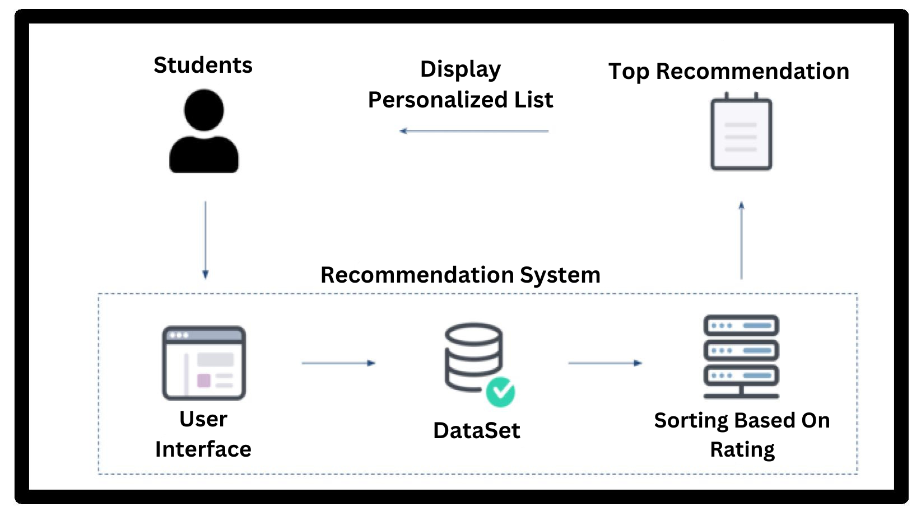
06
PROPOSED ARCHITECTURE

Slide 14
07
PROPOSED ALGORITHM
User input: User selects a service category (e.g., PG/ hostel).
Filter services: Apply content-based filtering based on user input and service descriptions.
Rating : Rank the filtered services based on a combination of content-based filtering scores, considering user preferences and other factors.
Recommendation: Present the top X services to the user.
Personalization: Allow users to adjust recommendation parameters.
Feedback loop: Integrate user feedback (ratings, reviews) to improve recommendations over time.
Privacy: Ensure data privacy and security for user and service information.

Slide 15
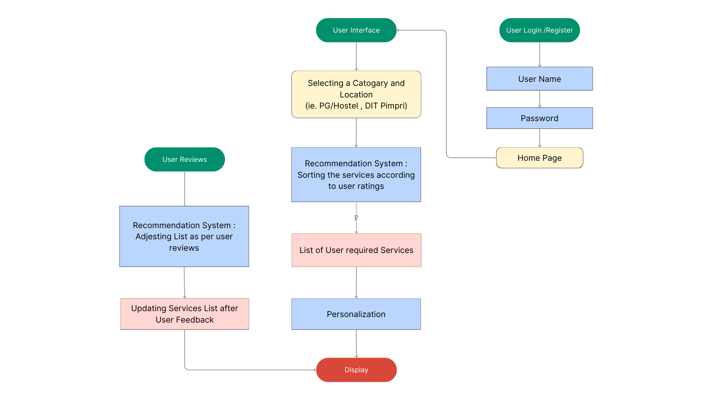
08
BLOCK DIAGRAM

Slide 16
09
SOFTWARE AND HARDWARE REQUIREMENTS
Web Development Tools : Such as HTML, CSS, JavaScript for front-end development.
Back-end Development Framework : Django, Flask (Python), Node.js (JavaScript).
Database Management System (DBMS) : MySQL for storing user data and preferences.
Machine Learning Libraries : NumPy , Pandas.
Version Control System : Git for collaborative development and managing code versions.
Integrated Development Environment (IDE) : Visual Studio Code, PyCharm for coding and debugging.
Web Server : Apache for hosting the web application.
No As such Hardware Requirement.

Slide 17

10
ADVANTAGES
Enhanced User Experience : AssistU enhances user experience with personalized recommendations for campus services.
Time Efficiency : Students save time with relevant suggestions based on preferences, simplifying service discovery.
Convenience : AssistU improves convenience by facilitating access to essential campus services, reducing stress.
Accuracy and Relevance : Utilizing machine learning, AssistU ensures precise and tailored recommendations, meeting individual user needs effectively.

Slide 18
11
LIMITATIONS :
Dependency on User Input : Recommendations depend on user input quality, affecting accuracy.
Limited Coverage : Sparse service options near campus may limit effectiveness.
Bias in Recommendations : Machine learning may introduce biases, impacting fairness.
Adaptation to Changing Preferences : Continuous updates needed to reflect evolving preferences and service availability.

Slide 19

12
APPLICATION :
Certainly! Here are the four important applications of the AssistU project:
College Campuses : Streamlining access to essential services for students, including dining, housing, medical care, and academic resources.
Urban Areas : Assisting residents and visitors in navigating services in student-centric urban zones with multiple colleges.
Tourism and Travel : Offering personalized recommendations for tourists in unfamiliar locations, covering hotels, restaurants, attractions, and transportation.
Corporate Campuses : Facilitating employee access to services within large corporate campuses, encompassing dining, fitness, transportation, and amenities.

Slide 20




13
FUTURE SCOPE
Integration of Emerging Technologies: Exploring AR or VR to enhance user engagement through immersive experiences.
Expansion to New Markets: Targeting demographics beyond college campuses, such as high school students, young professionals, and tourists.
Enhanced Personalization: Utilizing advanced machine learning and data analytics for personalized recommendations based on contextual factors.
Partnerships and Collaborations: Forming alliances with local businesses and stakeholders to support expansion and foster community engagement.

Slide 21
14
CONCLUSION
This project built a website recommending college services like PG/hostels, laundry, and clinics. It simplifies service discovery for students, saving them time and effort. Key features include personalized recommendations based on user preferences and consolidating user ratings. Ultimately, this project empowers students, offers a valuable resource for the college community.

Slide 22
15
REFERENCES
[1] Mr. Nikhil Falke, Mr. Abhishek Kiranrao Dabhade, Miss. Ashvini Rangraoji Bansod, Mr. Nirmal Sureshkumar Bajaj , Mr. Chaitanya Harish Tayade , Prof. Y. R. Shelokar, “Implementation of Online Mess Recommender System using Sentiment Analysis”,UG Scholar, Professor, Computer Science & Engineering Dr. Rajendra Gode Institute of Technology and Research, Amravati, Maharashtra.ISSN: 2321-9653; 2023
[2] Mandeep Katre (Professor) ,Kumar Abhay Gupta , Shipra Katiyar , Saumya Shahi , Shreya Awasthi, “A Review Paper on PG Recommendation System” ,Department of Computer Science & Engineering, Inderprastha Engineering College, Ghaziabad, Uttar Pradesh. ISSN: 2321-9653; 2023
[3] Sanjivani Adsul, Disha Borale, Yash Divate, Tanvi Diwnale, Shardul Dixit, Pornima Dokhale, Shreyas Done, Rent Your Resi: “Hostel and Mess”, Vishwakarma Institute of Technology, Pune. ISSN : 2320-2882, 2023.
[4] Vineetha Rohra, Anurag Sukhija, Nikita Lalwani, Ajay Karare, “Mess Management System Implementation”, ICSTS-2015

Slide 23
THANK YOU

